Slide 1
Formal Relational Query Languages
Two mathematical Query Languages form the basis for “real” languages (e.g. SQL), and for implementation:
  Relational Algebra: More operational, very useful for representing execution plans.
  Relational Calculus: Lets users describe what they want, rather than how to compute it. (Non-operational, declarative.)
Slide No:L6-1

Slide 2
Preliminaries
A query is applied to relation instances, and the result of a query is also a relation instance.
  Schemas of input relations for a query are fixed (but query will run regardless of instance!)
  The schema for the result of a given query is also fixed! Determined by definition of query language constructs.
Positional vs. named-field notation:
  Positional notation easier for formal definitions, named-field notation more readable.
  Both used in SQL
Slide No:L6-2
Notes:
4

Slide 3
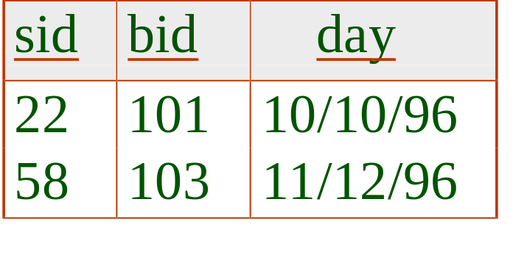
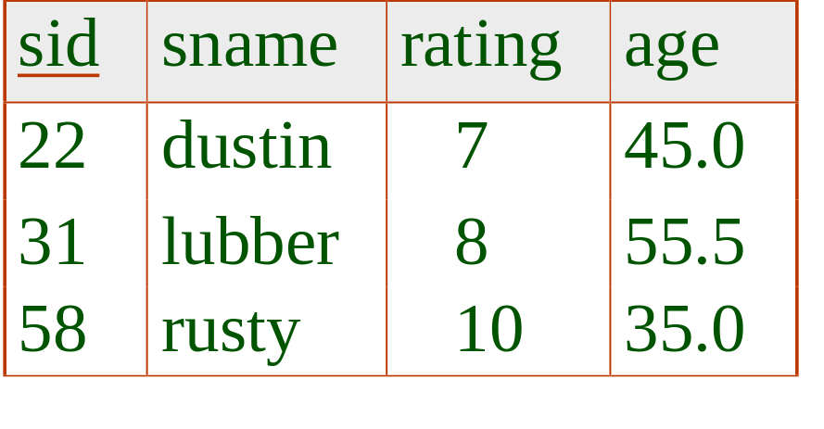
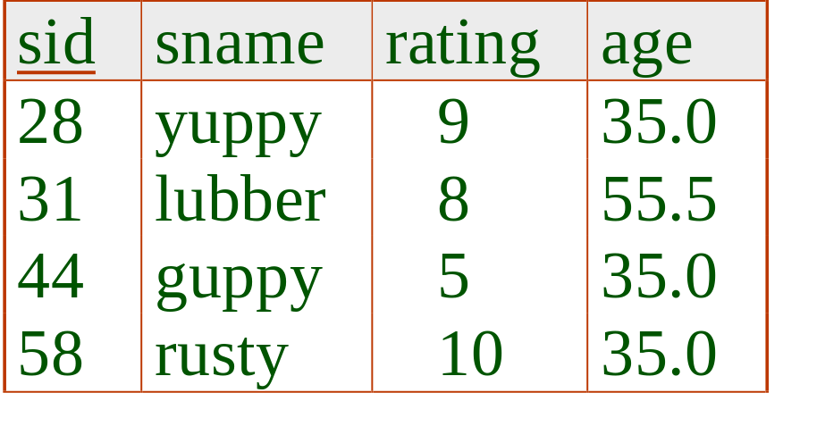
Example Instances
R1
“Sailors” and “Reserves” relations for our examples.
We’ll use positional or named field notation, assume that names of fields in query results are `inherited’ from names of fields in query input relations.
S1
S2
Slide No:L6-3
Notes:
5

Slide 4
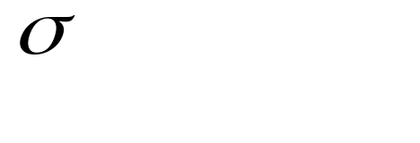
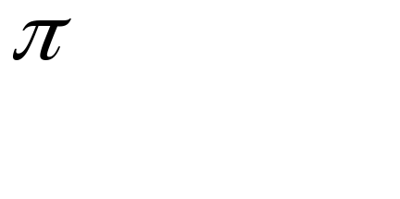



Relational Algebra
Basic operations:
  Selection ( ) Selects a subset of rows from relation.
  Projection ( ) Deletes unwanted columns from relation.
  Cross-product ( ) Allows us to combine two relations.
  Set-difference ( ) Tuples in reln. 1, but not in reln. 2.
  Union ( ) Tuples in reln. 1 and in reln. 2.
Additional operations:
  Intersection, join, division, renaming: Not essential, but (very!) useful.
Since each operation returns a relation, operations can be composed! (Algebra is “closed”.)
Slide No:L6-4
Notes:
6

Slide 5
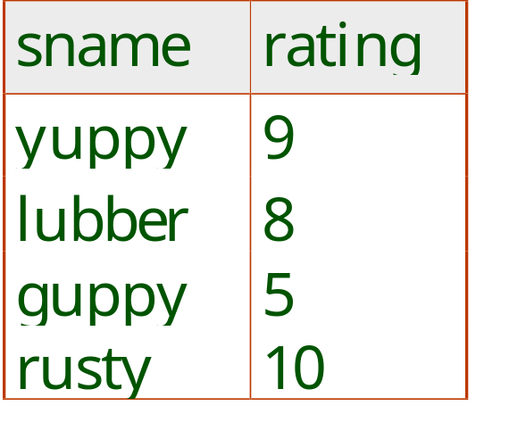
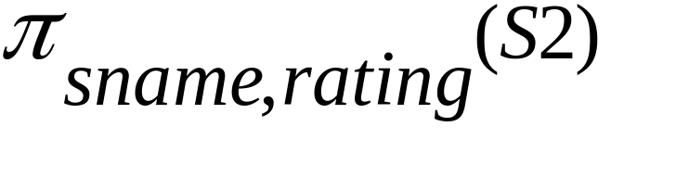
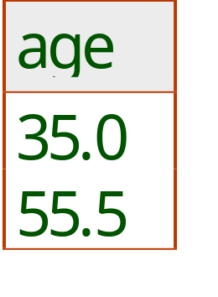
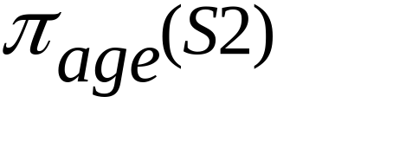
Projection
Deletes attributes that are not in projection list.
Schema of result contains exactly the fields in the projection list, with the same names that they had in the (only) input relation.
Projection operator has to eliminate duplicates! (Why??)
  Note: real systems typically don’t do duplicate elimination unless the user explicitly asks for it. (Why not?)
Slide No:L6-5
Notes:
7

Slide 6
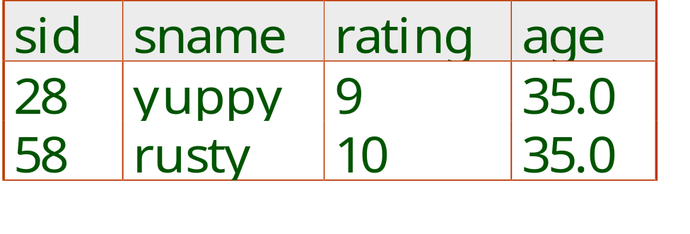
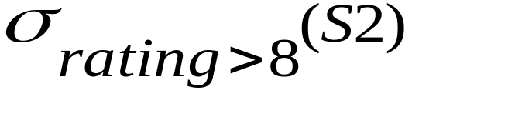
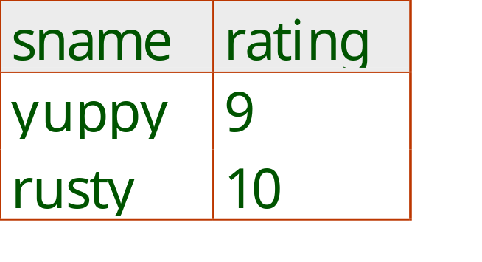
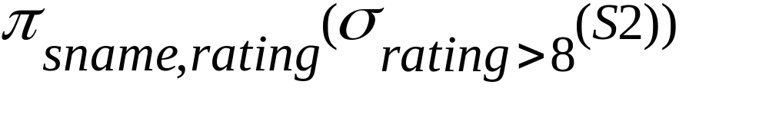
Selection
Selects rows that satisfy selection condition.
No duplicates in result! (Why?)
Schema of result identical to schema of (only) input relation.
Result relation can be the input for another relational algebra operation! (Operator composition.)
Slide No:L6-6
Notes:
8

Slide 7
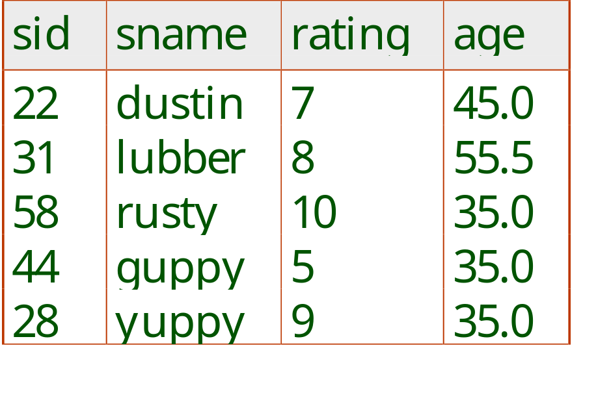
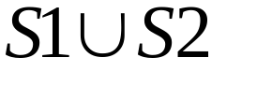
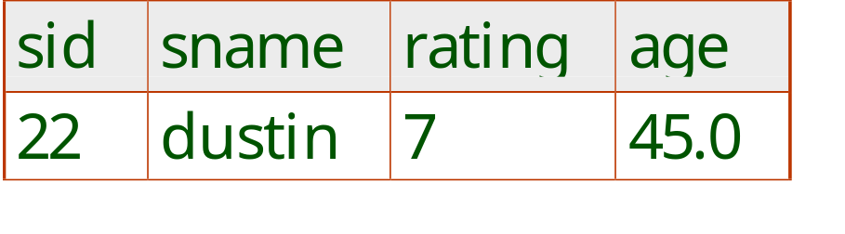
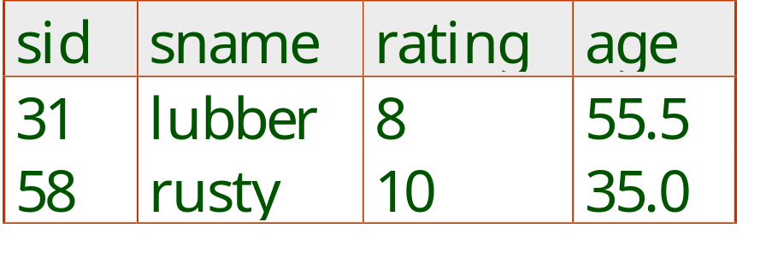

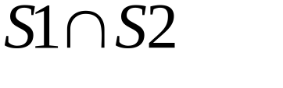
Union, Intersection, Set-Difference
All of these operations take two input relations, which must be union-compatible:
  Same number of fields.
  `Corresponding’ fields have the same type.
What is the schema of result?
Slide No:L6-7
Notes:
9

Slide 8
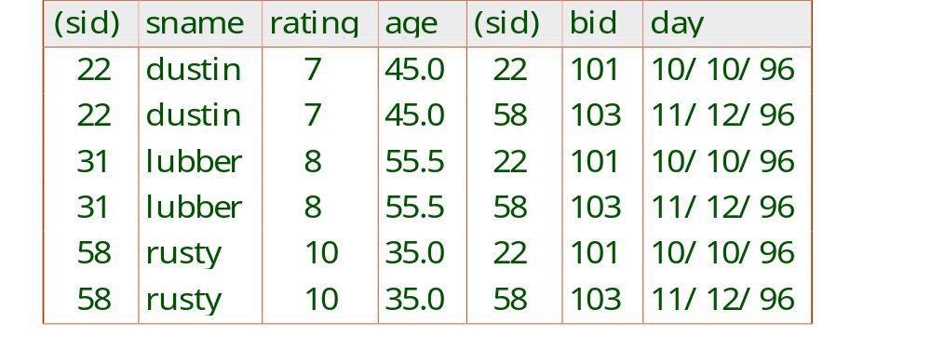
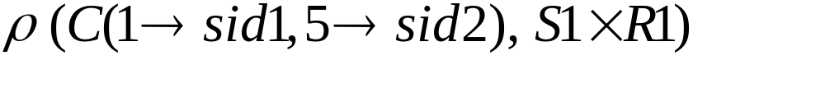
Cross-Product
Each row of S1 is paired with each row of R1.
Result schema has one field per field of S1 and R1, with field names `inherited’ if possible.
  Conflict: Both S1 and R1 have a field called sid.
Renaming operator:
Slide No:L6-8
Notes:
10

Slide 9

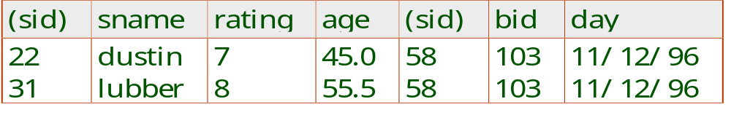
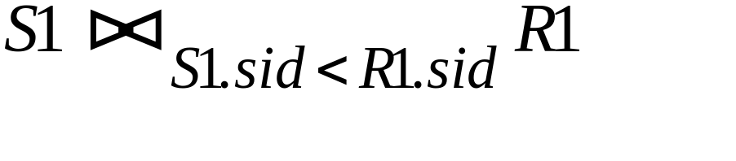
Joins
Condition Join:
Result schema same as that of cross-product.
Fewer tuples than cross-product, might be able to compute more efficiently
Sometimes called a theta-join.
Slide No:L6-9
Notes:
11

Slide 10
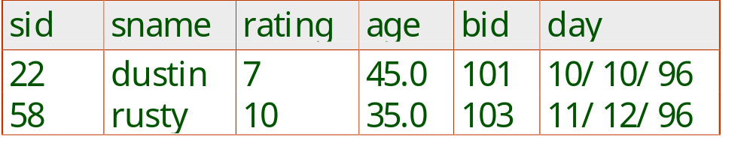
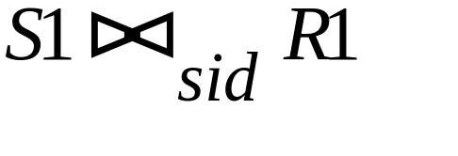
Joins
Equi-Join: A special case of condition join where the condition c contains only equalities.
Result schema similar to cross-product, but only one copy of fields for which equality is specified.
Natural Join: Equijoin on all common fields.
Slide No:L6-10
Notes:
12

Slide 11
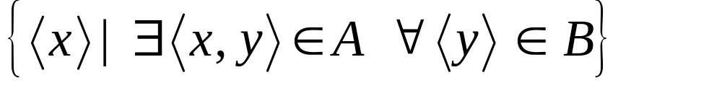

Division
Not supported as a primitive operator, but useful for expressing queries like: Find sailors who have reserved all boats.
Let A have 2 fields, x and y; B have only field y:
  A/B =
  i.e., A/B contains all x tuples (sailors) such that for every y tuple (boat) in B, there is an xy tuple in A.
  Or: If the set of y values (boats) associated with an x value (sailor) in A contains all y values in B, the x value is in A/B.
In general, x and y can be any lists of fields; y is the list of fields in B, and x y is the list of fields of A.
Slide No:L6-11
Notes:
13

Slide 12
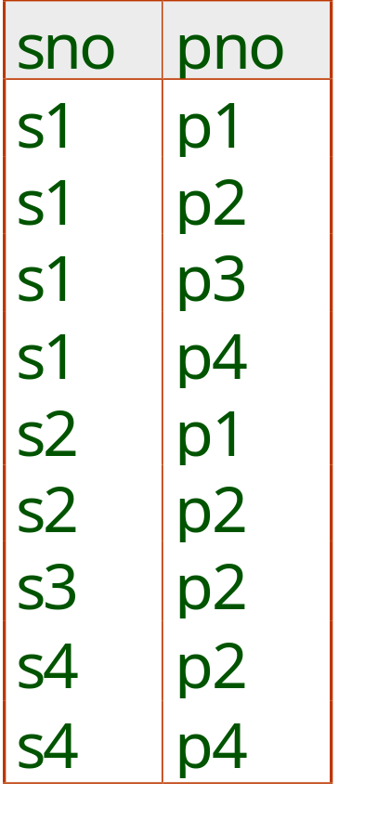
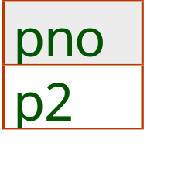
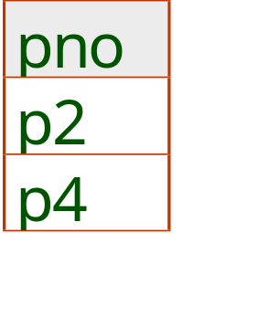
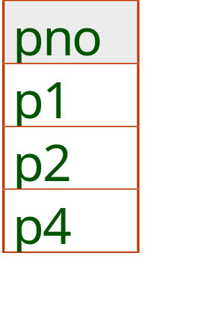
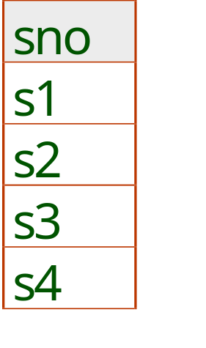
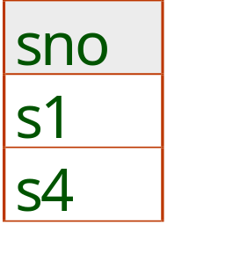
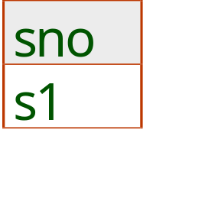
Examples of Division A/B
B1
B2
B3
A
A/B1
A/B2
A/B3
Slide No:L6-12
Notes:
14

Slide 13
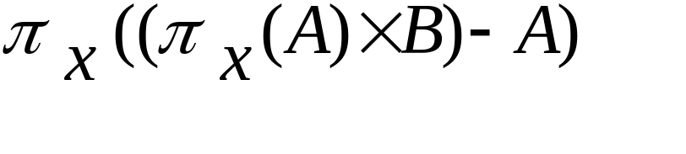
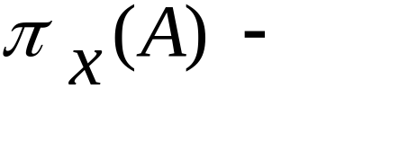
Expressing A/B Using Basic Operators
Division is not essential op; just a useful shorthand.
  (Also true of joins, but joins are so common that systems implement joins specially.)
Idea: For A/B, compute all x values that are not `disqualified’ by some y value in B.
  x value is disqualified if by attaching y value from B, we obtain an xy tuple that is not in A.
  Disqualified x values:
A/B:
all disqualified tuples
Slide No:L6-13
Notes:
15

Slide 14
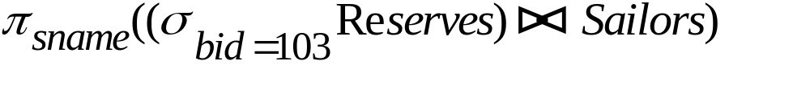
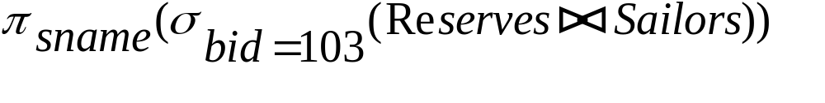
Find names of sailors who’ve reserved boat #103
Solution 1:
Solution 2:
Slide No:L6-14
Notes:
16

Slide 15
Find names of sailors who’ve reserved a red boat
Information about boat color only available in Boats; so need an extra join:
A more efficient solution:
A query optimizer can find this, given the first solution!
Slide No:L6-15
Notes:
17

Slide 16
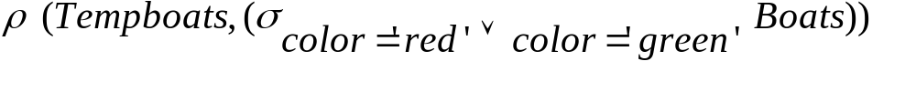
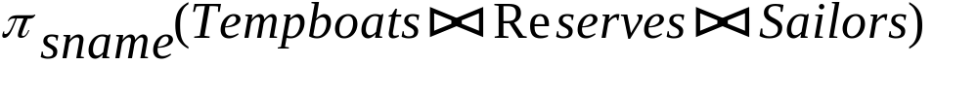


Find sailors who’ve reserved a red or a green boat
Can identify all red or green boats, then find sailors who’ve reserved one of these boats:
Can also define Tempboats using union! (How?)
What happens if is replaced by in this query?
Slide No:L6-16
Notes:
18

Slide 17
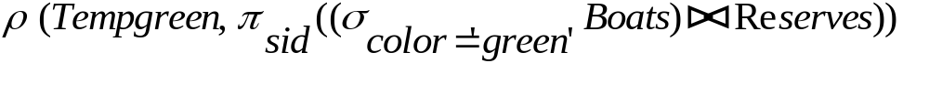
Find sailors who’ve reserved a red and a green boat
Previous approach won’t work! Must identify sailors who’ve reserved red boats, sailors who’ve reserved green boats, then find the intersection (note that sid is a key for Sailors):
Slide No:L6-17
Notes:
19

Slide 18
Relational Calculus
Comes in two flavors: Tuple relational calculus (TRC) and Domain relational calculus (DRC).
Calculus has variables, constants, comparison ops, logical connectives and quantifiers.
  TRC: Variables range over (i.e., get bound to) tuples.
  DRC: Variables range over domain elements (= field values).
  Both TRC and DRC are simple subsets of first-order logic.
Expressions in the calculus are called formulas. An answer tuple is essentially an assignment of constants to variables that make the formula evaluate to true.
Slide No:L7-1

Slide 19
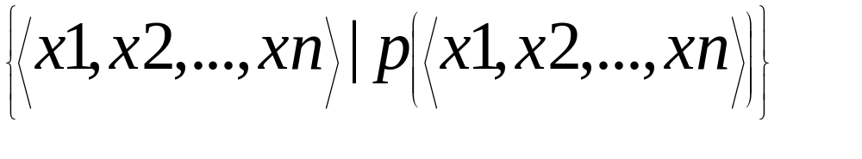
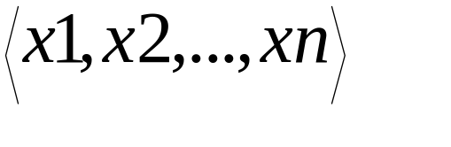
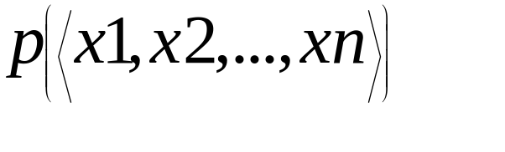
Domain Relational Calculus
Query has the form:
Answer includes all tuples that
make the formula be true.
Formula is recursively defined, starting with
simple atomic formulas (getting tuples from
relations or making comparisons of values),
and building bigger and better formulas using
the logical connectives.
Slide No:L7-2

Slide 20
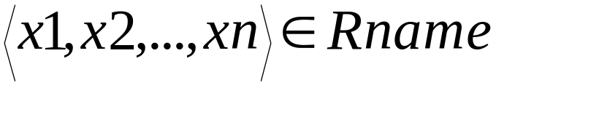

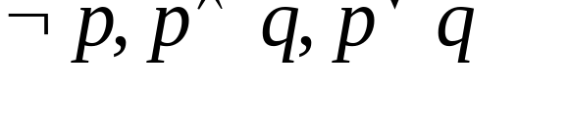
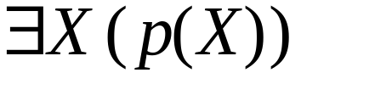
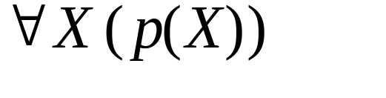

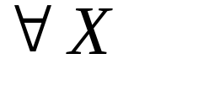
DRC Formulas
Atomic formula:
  , or X op Y, or X op constant
  op is one of
Formula:
  an atomic formula, or
  , where p and q are formulas, or
  , where variable X is free in p(X), or
  , where variable X is free in p(X)
The use of quantifiers and is said to bind X.
  A variable that is not bound is free.
Slide No:L7-3

Slide 21
Free and Bound Variables
The use of quantifiers and in a formula is said to bind X.
  A variable that is not bound is free.
Let us revisit the definition of a query:
There is an important restriction: the variables x1, ..., xn that appear to the left of `|’ must be the only free variables in the formula p(...).
Slide No:L8-1

Slide 22
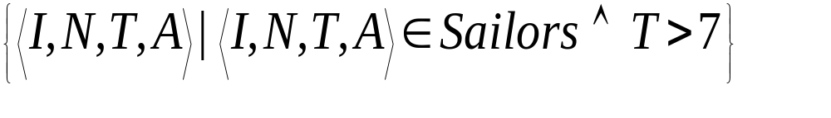
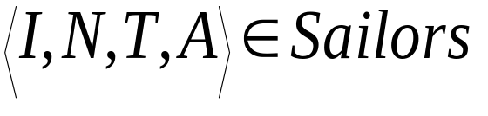
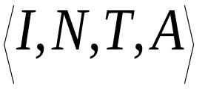
Find all sailors with a rating above 7
The condition ensures that the domain variables I, N, T and A are bound to fields of the same Sailors tuple.
The term to the left of `|’ (which should be
read as such that) says that every tuple that satisfies T>7 is in the answer.
Modify this query to answer:
  Find sailors who are older than 18 or have a rating under 9, and are called ‘Joe’.
Slide No:L8-2

Slide 23




Find sailors rated > 7 who have reserved boat #103
We have used as a shorthand for
Note the use of to find a tuple in Reserves that `joins with’ the Sailors tuple under consideration.
Slide No:L8-3

Slide 24
Find sailors rated > 7 who’ve reserved a red boat
Observe how the parentheses control the scope of each quantifier’s binding.
This may look cumbersome, but with a good user interface, it is very intuitive. (MS Access, QBE)
Slide No:L8-4

Slide 25




Find sailors who’ve reserved all boats
Find all sailors I such that for each 3-tuple either it is not a tuple in Boats or there is a tuple in Reserves showing that sailor I has reserved it.
Slide No:L8-5

Slide 26



Find sailors who’ve reserved all boats (again!)
Simpler notation, same query. (Much clearer!)
To find sailors who’ve reserved all red boats:
.....
Slide No:L8-6

Slide 27

Unsafe Queries, Expressive Power
It is possible to write syntactically correct calculus queries that have an infinite number of answers! Such queries are called unsafe.
  e.g.,
It is known that every query that can be expressed in relational algebra can be expressed as a safe query in DRC / TRC; the converse is also true.
Relational Completeness: Query language (e.g., SQL) can express every query that is expressible in relational algebra/calculus.
Slide No:L8-7

